Slide 1
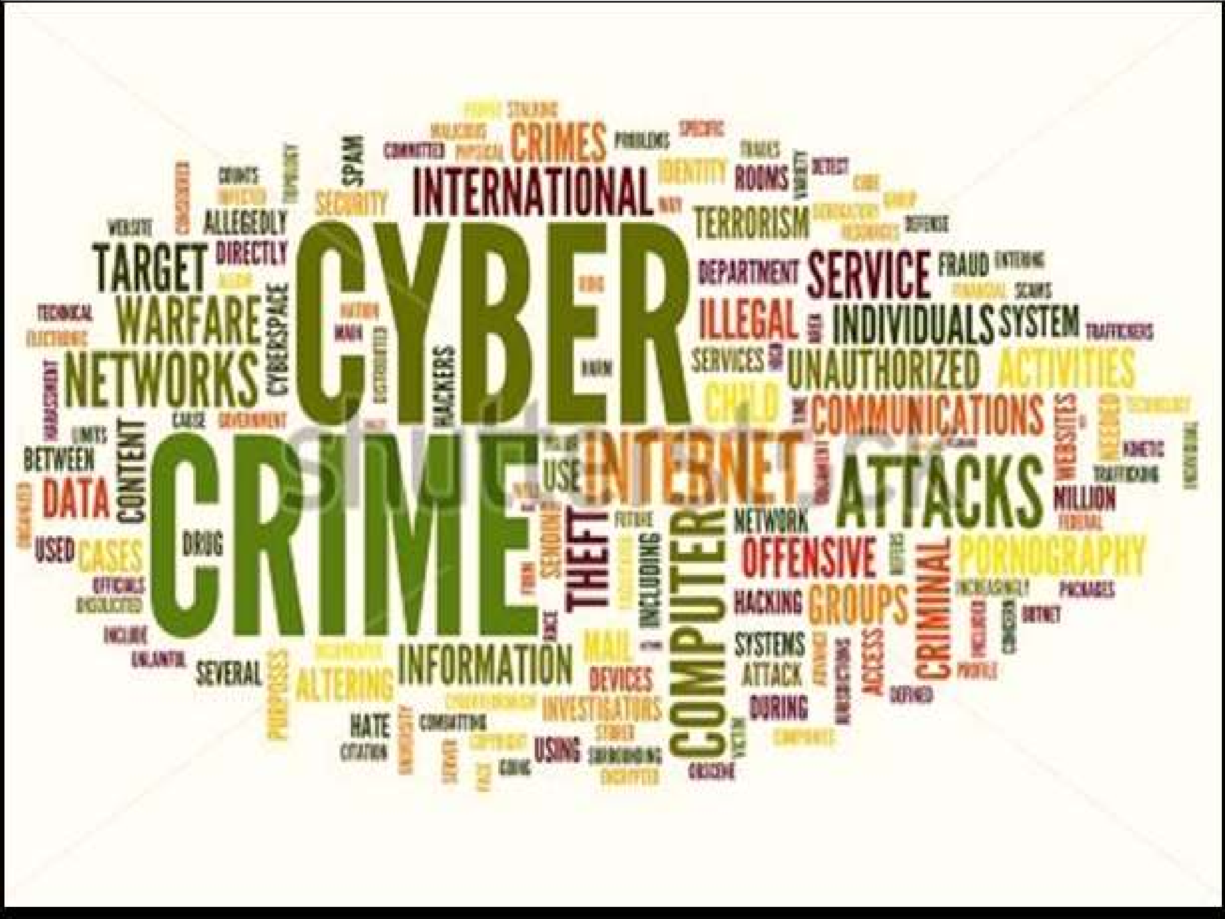

Cyber Crimes
Crimes are not to be measured by the issue of events, but by the bad intensions.

Slide 2
Background
Term ‘Crime’ is defined as an act, which may leads to legal punishment or any offence against morality, social order or any unjust or shameful act.
The “Offence" is defined in the Code of Criminal Procedure to mean as an act or omission made punishable by any law for the time being in force.
Cyber Crimes involve cyber technologies.
Modern business process is done through utilizing computer software and hardware, i.e. some form of computer system is used in it.
There has been a sharp rise in the number of crimes involving computing; and the Internet has undoubtedly created new security risks.
Cyber Crime is emerging as a serious threat World wide.
Law enforcing agencies and intelligence units have started to react.

Slide 3
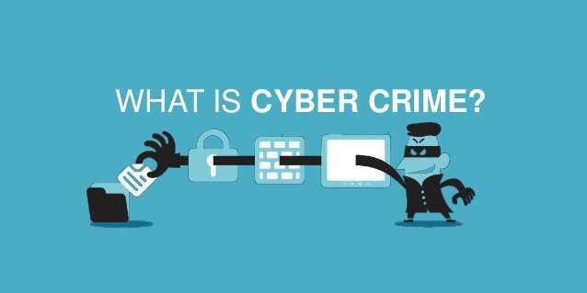
Cyber Crimes
Notes:
When any crime is committed over the Internet using digital devices it is referred to as a cyber crime.
When you purchase a home it comes with a door and lock .you always ensure that your lock and doors are working properly . you may even purchase a security system.
Likewise , your system is your home and security tools are door / locks and security tools.
So if someone breaches into your home’s(system), access all you personal account and tempers your data , is the criminal who is committing the crime.
And committed crime is known as cyber crime.
That means we can say that cyber crime is an illegal activity committed on the internet.

Slide 4
Cyber Crimes
Any activity commissioned via computer, digital devices and networks used in the cyber realm, and is facilitated through the internet medium.
It can include the distant theft of information belonging to an individual, government or corporate sector through criminal tress-passing into unauthorized remote systems around the world.
It includes from stealing millions of rupees from online bank to harassing and stalking cyber users.
Notes:
http://www.nr3c.gov.pk/cybercrime.html
Cyber Crime is a term used to broadly describe criminal activity in which computers or computer networks are a tool, a target, or a place of criminal activity and include everything from electronic cracking to denial of service attacks. It is also used to include traditional crimes in which computers or networks are used to enable the illicit activity.

Slide 5
Cyber Crimes
Computer crime mainly consists of unauthorized access to computer systems, data alteration, data destruction, theft of intellectual property.
Cyber crime in the context of national security may involve hacking, traditional espionage, or information warfare and related activities.
It also includes sending viruses on different systems, or posting defamation messages.
Commission of cyber crime can be:
The computer as a target-attacking the computers (e.g. spreading viruses etc.)
The computer as a weapon-to commits fraud or illegal gambling
The computer as an accessory- to store illegal or stolen information

Slide 6
Cyber Crime Facts
Cyber crime has now beaten illegal drug marketing as a criminal moneymaker
Somebody’s identity is stolen every Three seconds as a result of cyber crime.
Without a sophisticated security package, your unprotected PC can become infected within four minutes of connecting to the Internet.
Notes:
http://www.nr3c.gov.pk/cybercrime.html

Slide 7
Major Online Activities
Social networking
Online banking
Internet surfing
Audio & video communication
Entertainment
Online shopping
Map directions / GPS
Online education
Online auction
Information sharing
Medical assistance
Online games
In Pakistan, internet users range from 10% to 16% of the overall population.
Notes:
http://www.nr3c.gov.pk/cybercrime.html

Slide 8

Common types of Cyber Crimes
Frauds (Financial etc.)
Hacking
Identity theft
Cyber Stalking
Digital Piracy
Malicious Software, Computer viruses and worms
Intellectual property rights
Money Laundering
Denial of Service attack
Electronic Terrorism, Vandalism and Blackmail
Notes:
As the Internet, mobile phones, and other computer technologies have flourished, criminals have found ways to use them for old-fashioned goals such as theft, fraud, and harassment etc.
Pornography, Threatening Email, Assuming someone's Identity, Sexual Harassment, Defamation, Spam and Phishing are some examples where computers are used to commit crime, whereas Viruses, Worms and Industrial Espionage, Software Piracy and Hacking are examples where computers become target of crime.

Slide 9

On Line Scams/ Frauds

Slide 10
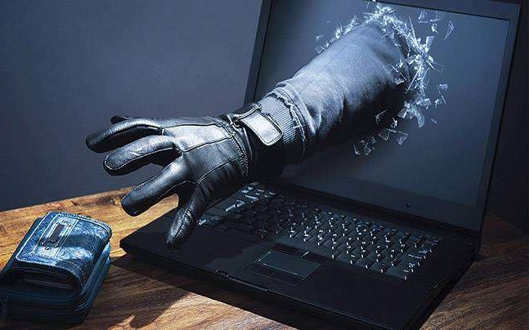
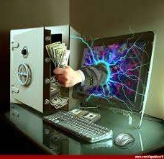

Computer Misuse Practices
Under the study of the English criminal law, the Law Commission highlighted a number of categories of misuse of computers
Computer fraud
Unauthorized obtaining of information from a computer
Computer hacking
Eavesdropping on a computer
Making unauthorized use of computers for personal benefit
Unauthorized alteration or destruction of information stored on a computer
Denying access to an authorized user
The unauthorized removal of information stored on a computer

Slide 11
Computer Fraud
The Law Commission defined computer fraud as conduct which involves the manipulation of a computer or internet, by whatever method, in order dishonestly to obtain money, property, or some other advantage of value, or to cause loss
Computer fraud is further divided into three categories
Input frauds
e.g. intentionally entering false data or amending data into the computer
Output frauds
Output fraud involves stealing or misusing system output
Program frauds
Program fraud involves the dishonest alteration of a computer program
Notes:
Most forms of Internet fraud are financial in nature
Cybercriminals may hack into personal financial accounts to access funds
Might attack website databases in order to gain access to consumer details, such as Social Security numbers, that can be used to take out credit cards or loans in another person’s name

Slide 12
Computer Fraud
Most forms of Internet fraud are financial in nature
Cybercriminals may hack into personal financial accounts to access funds

Slide 13
Financial Fraud
Financial fraud is a criminal behavior in which a person uses wrong methods to trick a victim out of his money.
The Internet fraud scheme is a common example of financial fraud, which includes emulated online sales, retail schemes, business opportunity schemes, identity theft, market manipulation schemes, and credit card schemes.

Slide 14
Computer Trespassing
Cybercriminals can gain access to individual computers to peek through files, website browsing history, access passwords, or possibly even save files to your machine
This type of fraud is known as computer trespass
In many cases, computer trespassing is accomplished by luring people to click on attachments or download files.

Slide 15
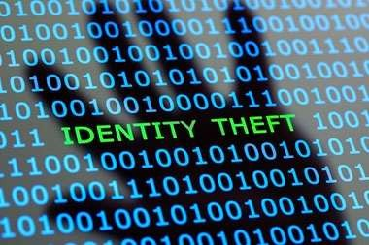

Slide 16
Identity Theft
Refers to a crime where an individual maliciously obtains and uses another individuals personal/sensitive information to commit frauds/scams by using the stolen identity.
Mostly this crime is committed for economic gain.
The cyber criminal gains access to an individuals information by stealing e-mail details, stored information on computer databases, they eavesdrop over the networks to get hold of transactions.
Identity thefts includes but not limited to shoulder surfing, dumpster diving, spamming, spoofing, phishing, and skimming.
NATIONAL RESPONSE CENTRE FOR CYBER CRIME (NR3C) - FEDERAL INVESTIGATION AGENCY PAKISTAN
has successfully investigated numerous cases of identity theft.
Notes:
http://www.nr3c.gov.pk/crimecategorie.html
When a criminal gains access to your personal information (such as your name, address, date of birth or bank account details) to steal money or gain other benefits.
They can also use your personal information to create fake identity in your name
How does identity theft occur?
Criminals may attempt to gain your personal information using a number of different techniques
Phishing: you may provide personal information over the phone or internet

Slide 17
Data Theft
It is the act of stealing computer-based information from an unknowing victim with the intent of compromising privacy or obtaining confidential information.
Data theft is increasingly a problem for individual computer users, as well as big corporate firms.
Following categories are most common in data theft cases.
E-commerce: You should make sure that your data is safe from prying eyes when you sell or buy things on the Web. Carelessness can lead to leaking your private account information.
Password cracking: Intruders can access your machine and get valuable data if it is not password-protected or its password can be easily decoded (weak password).
Eavesdropping: Data sent on insecure lines can be wiretapped and recorded. If no encryption mechanism is used, there is a good chance of losing your password and other private information to the eavesdropper.
Laptop theft: Increasingly incidents of laptop theft from corporate firms occur with the valuable information stored in the laptop being sold to competitors. Carelessness and lack of laptop data encryption can lead to major losses for the firm.

Slide 18
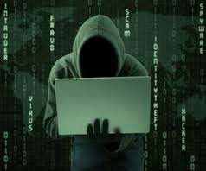
Hacking
Trying to get into computer systems in order to steal, corrupt, or illegitimately view data.
Hacking comes from the term “hacker”, who is an expert in computer programming languages and systems.
Accomplished by using unusually complex and clever methods to make computers do things.
The proper term for “Hacker” is “cracker”, and that their activities should be called cracking.
However, the most common usage of the word, “hacking” refers to an unauthorized access.

Slide 19
Website Defacement
An attack on a website that changes the visual appearance of the site or a webpage.
This is typically the work of system crackers, who break into a web server and replace the hosted website with one of its own.
The most common method of defacement is using SQL Injections to log on to administrator accounts.
Defacements usually consist of an entire page.
This page usually includes the defacer’s pseudonym or “Hacking Codename.”
Sometimes, the Website Defacer makes fun of the system administrator for failing to maintain server security.
Most times, the defacement is harmless, however, sometimes it can be used as a distraction to cover up more sinister actions such as uploading malware or deleting essential files from the server.
NR3C has successfully investigated website defacement cases.

Slide 20
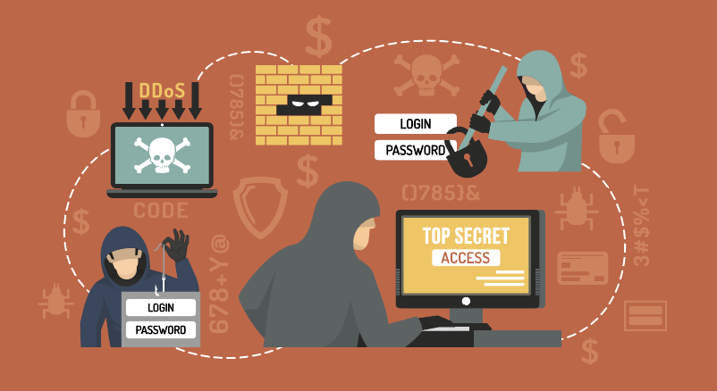
Social Engineering Attacks
Social Engineering Attack: Hacks by Manipulating Human Psychology

Slide 21
Social Engineering
These are techniques used by cyber criminals to get access to confidential information.
With social engineering, attackers use manipulation and deceit to trick victims into giving out confidential information.
Some of the social engineering methods used by attackers:
Sending messages that contain dangerous attachments (e.g. malware) with text that encourage people to open the attachments.
Pretending to be the main administrator of a local network and asking for the victim’s password in order to perform a maintenance check.
Telling a victim over the phone that he/she has won a prize, in return they ask for a credit card number to deliver it.
Asking for a user’s password for a certain Internet service, such as a blog, and later use the same password to access user’s computer. This technique works because users often use the same passwords for many different portals.

Slide 22
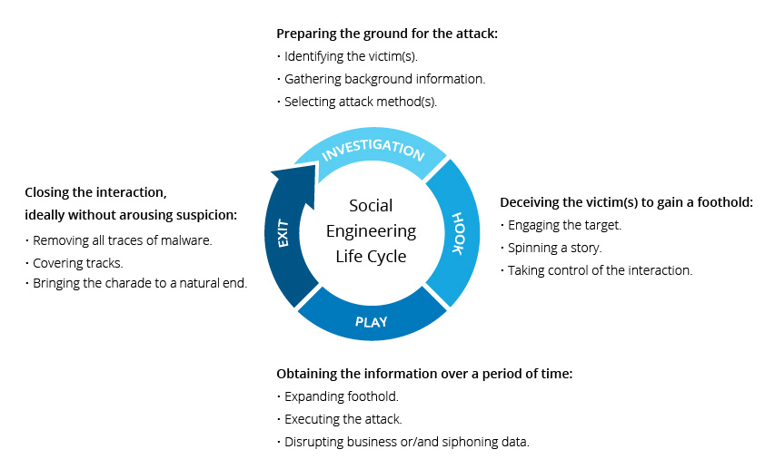
Life cycle of Social Engineering Attacks

Slide 23
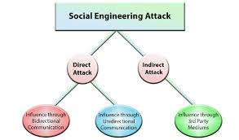
Classifications of Attacks

Slide 24
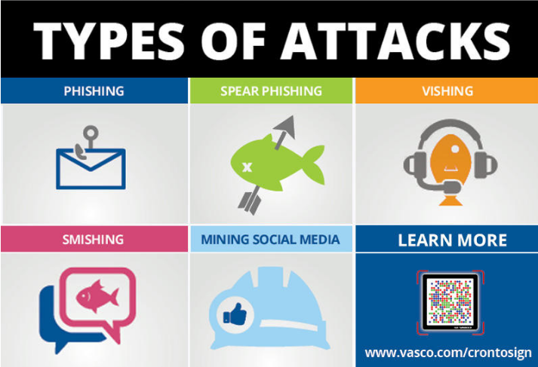
Social Engineering

Slide 25
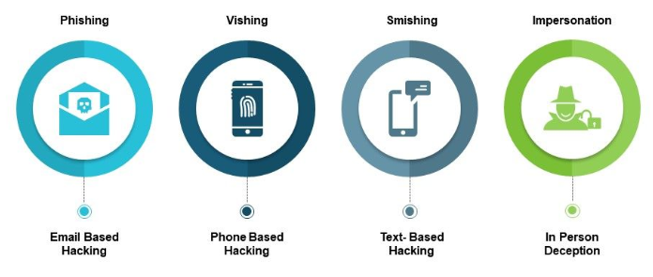
Range of Social Engineering Attacks

Slide 26
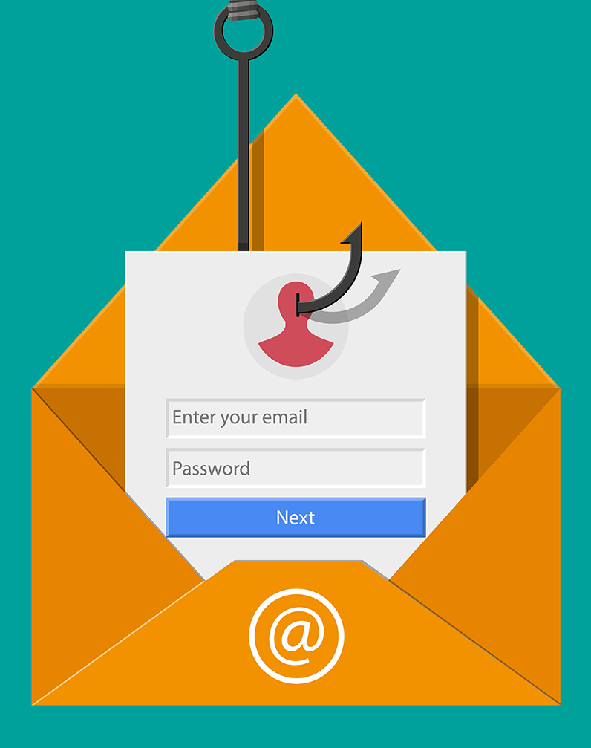
Spam and Phishing
Unsolicited mass e-mail, known colloquially as “spam”
Spam messages can be used to trick people into giving up sensitive personal information phishing
As carriers for computer worms and viruses
Spam e-mail could leave you vulnerable to spoofing, where a spammer gains the ability to send more of this junk e-mail through your account

Slide 27
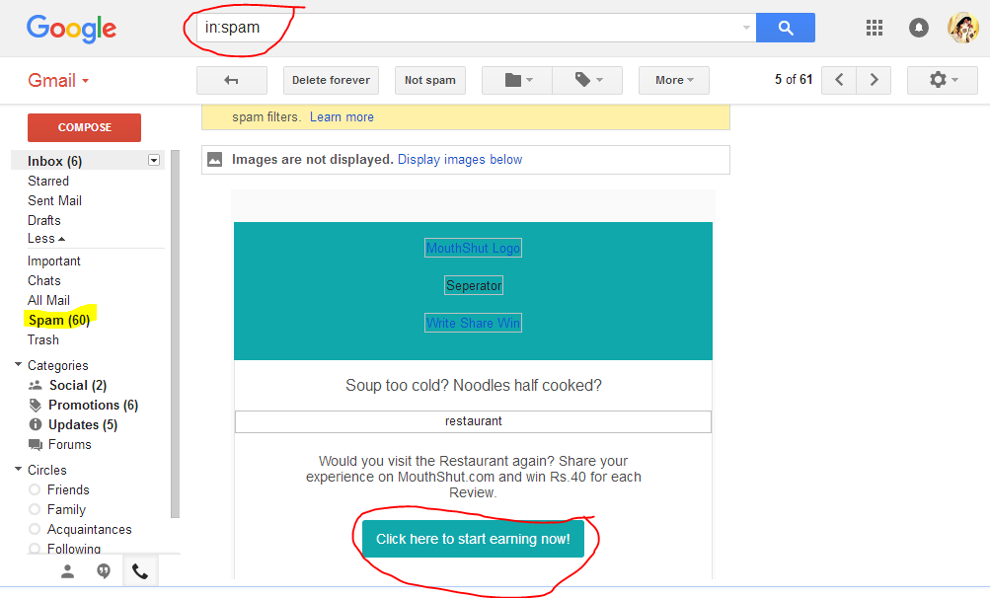
Spam and Phishing
Do not respond to phishing messages. Best thing to do is delete it.
Notes:
Phishing messages often imagine to come from legal businesses, such as banks or telecommunications providers.
Phishing is the practice of attracting users to visit fake Web sites in order to steal passwords, pin numbers and other sensitive information.
Explore Various Types of Phishing?

Slide 28
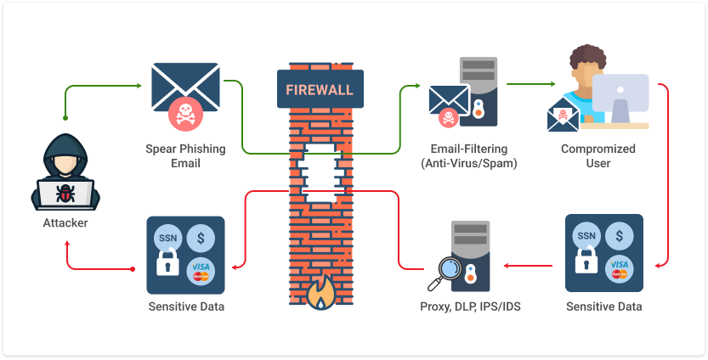
Information Stealing through Phishing

Slide 29
Example of Phishing
Mark is 42 years old and lives in Adelaide.
He receives an email from his bank which says his internet banking password needs to be changed.
He clicks the link in the email and resets his password.
The next day, he realizes that the email was not actually from his bank. He checks his account and finds $1000 is missing.

Slide 30
Blackmailing, Harassment, and Stalking
Several high-profile cases of teenagers bullying one another over the Internet
Bullies posted obscene or cruel messages to the victim on social media sites like Facebook, uploaded embarrassing videos
Information is often handed to the criminals by the victims themselves.
Unwary social media site users can give away their name, age, occupation, home and work addresses, or even their current location by using sites such as Foursquare or Facebook known as stalking
Notes:
Cyber stalking (also called cyber harassment) is when someone uses the Internet to threaten or make unwanted advances towards someone else.
This sort of harassment can cause physical, emotional, and psychological damage to the victim.
Children are particularly vulnerable because of their trusting nature and give away their personal information.
This information later is used against them for stalking purpose, therefore it id advised that until the person is not a trusted individual, no information should shared over the internet.

Slide 31
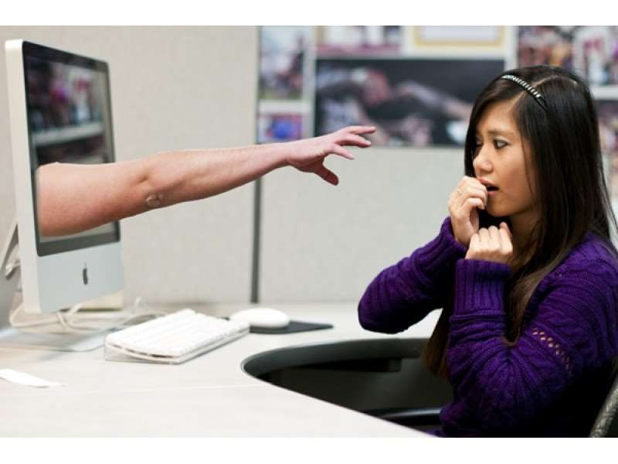
Cyber Stalking
This is a kind of online harassment wherein the victim is subjected to a barrage of online messages and emails.
Typically, these stalkers know their victims and instead of resorting to offline stalking, they use the Internet to stalk.
However, if they notice that cyber stalking is not having the desired effect, they begin offline stalking along with cyber stalking to make the victims’ lives more miserable.

Slide 32
Malicious Software
Criminals may use malicious software (or malware) to monitor your online activity and cause damage to the computer.
can also be used to steal your usernames, passwords or other information.
Malware is often downloaded when people open an infected email attachment or click a mistrustful link in an email.
Different types of malware include viruses, worm, spyware, adware, ransomware, and Trojan horses.

Slide 33
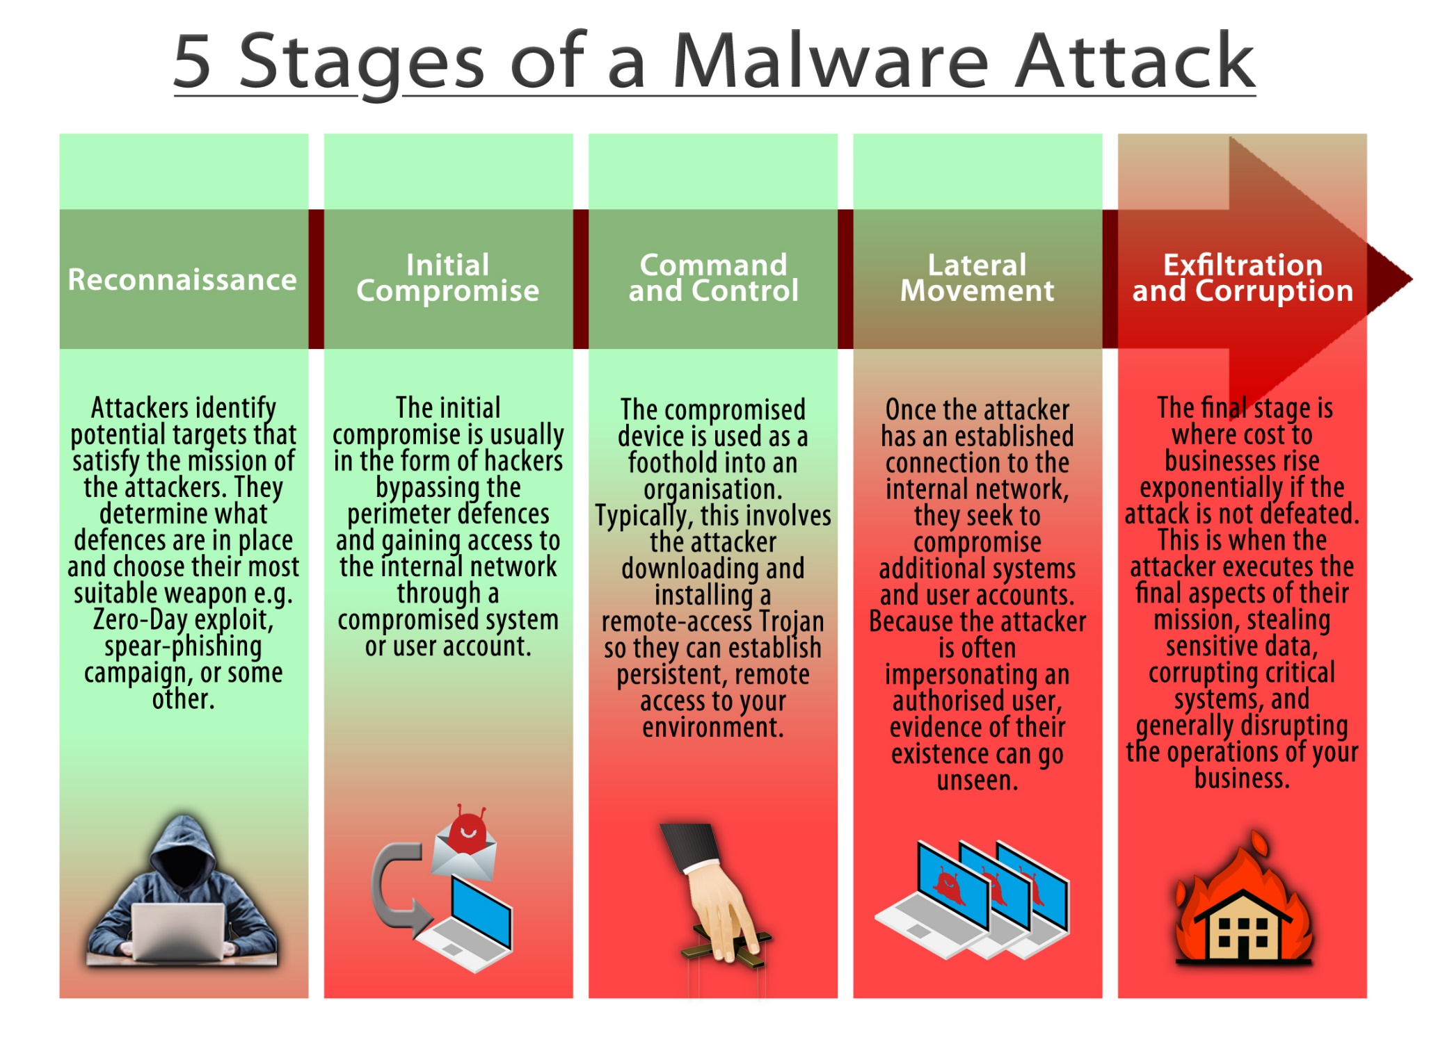

Slide 34
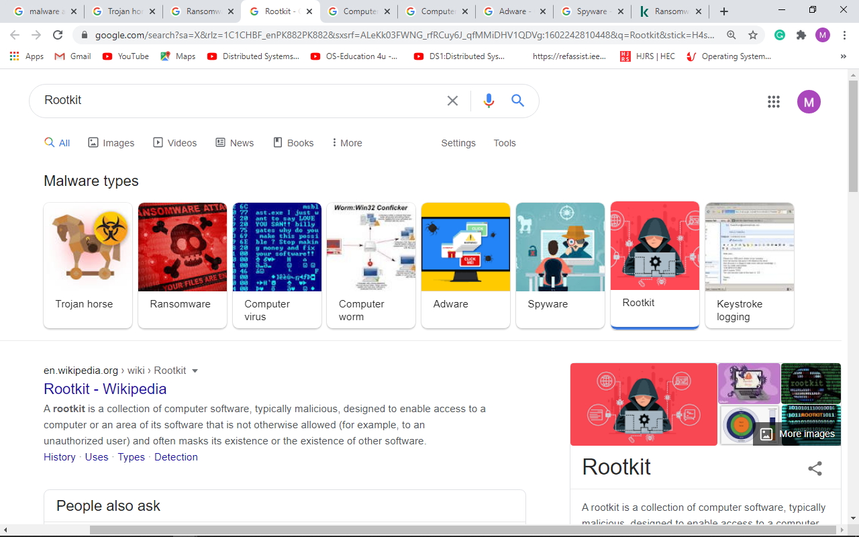
Common Malware Types

Slide 35

Computer Virus
A computer virus is a type of computer program that, when executed, replicates itself by modifying other computer programs and inserting its own code.
When this replication succeeds, the affected areas are then said to be "infected" with a computer virus.

Slide 36
Computer Worm
It is a standalone malware computer program that replicates itself in order to spread to other computers.
It often uses a computer network to spread itself, relying on security failures on the target computer to access it.
It will use this machine as a host to scan and infect other computers. When these new worm-invaded computers are controlled, the worm will continue to scan and infect other computers using these computers as hosts, and this behavior will continue

Slide 37
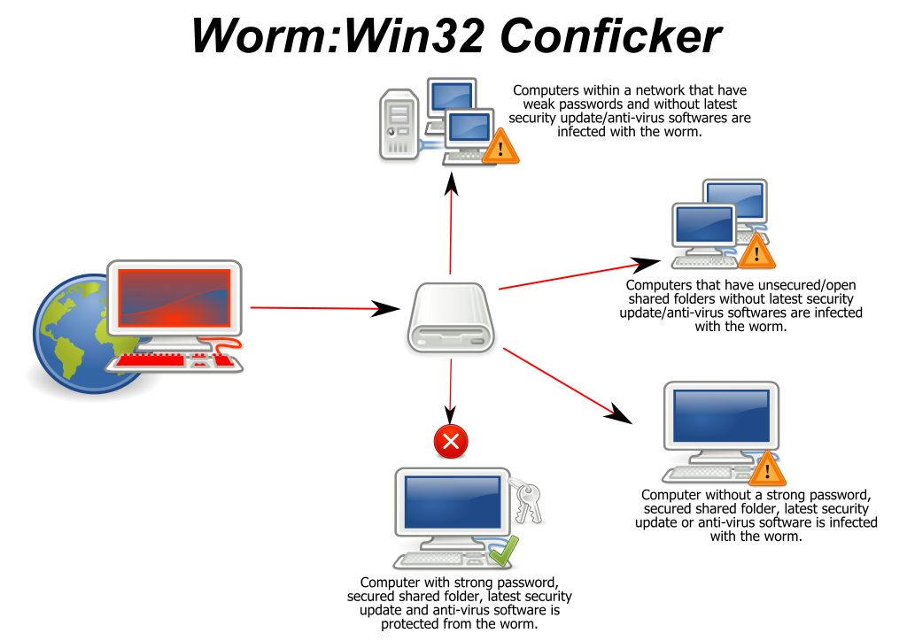
Computer Worm

Slide 38
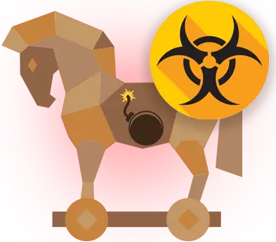
Trojan horse
In computing, a Trojan horse, or Trojan, is any malware which misleads users of its true intent. The term is derived from the Ancient Greek story of the deceptive Trojan Horse that led to the fall of the city of Troy.

Slide 39

Spyware
Spyware is a type of malware made to see and manipulate data on your device.
It is a software with malicious behavior that aims to gather information about a person or organization and send such information to another entity in a way that harms the user; for example by violating their privacy or endangering their device's security.

Slide 40
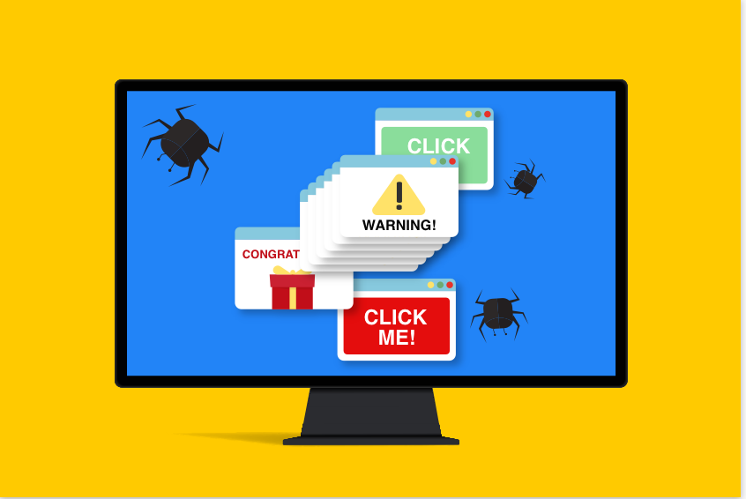
Adware
It is often called advertising-supported software by its developers to generate revenue for its developer by automatically generating online advertisements in the user interface of the software or on a screen presented to the user during the installation process.

Slide 41
Ransomware
It is a type of malware from crypto-virology that threatens to publish the victim's data or perpetually block access to it unless a ransom is paid.
Ransomware attacks are typically carried out using a Trojan that is disguised as a legitimate file that the user is tricked into downloading or opening when it arrives as an email attachment.
Notes:
File system defenses against ransomware
A number of file systems keep snapshots of the data they hold, which can be used to recover the contents of files from a time prior to the ransomware attack in the event the ransomware does not disable it.
On Windows, the Volume shadow copy (VSS) is often used to store backups of data; ransomware often targets these snapshots to prevent recovery and therefore it is often advisable to disable user access to the user tool VSSadmin.exe to reduce the risk that ransomware can disable or delete past copies.
On Windows 10, users can add specific directories or files to Controlled Folder Access in Windows Defender to protect them from ransomware.^{[132]} It is advised to add backup and other important directories to Controlled Folder Access.
File servers running ZFS are almost universally immune to ransomware, because ZFS is capable of snapshotting even a large file system many times an hour, and these snapshots are immutable (read only) and easily rolled back or files recovered in the event of data corruption.^{[133]} In general, only an administrator can delete (but cannot modify) snapshots.
File decryption and recovery
There are a number of tools intended specifically to decrypt files locked by ransomware, although successful recovery may not be possible.^{[2][134]} If the same encryption key is used for all files, decryption tools use files for which there are both uncorrupted backups and encrypted copies (a known-plaintext attack in the jargon of cryptanalysis. But, it only works when the cipher the attacker used was weak to begin with, being vulnerable to known-plaintext attack); recovery of the key, if it is possible, may take several days.^{[135]} Free ransomware decryption tools can help decrypt files encrypted by the following forms of ransomware: AES_NI, Alcatraz Locker, Apocalypse, BadBlock, Bart, BTCWare, Crypt888, CryptoMix, CrySiS, EncrypTile, FindZip, Globe, Hidden Tear, Jigsaw, LambdaLocker, Legion, NoobCrypt, Stampado, SZFLocker, TeslaCrypt, XData.^{[136]}
In addition, old copies of files may exist on the disk, which has been previously deleted. In some cases, these deleted versions may still be recoverable using software designed for that purpose.

Slide 42
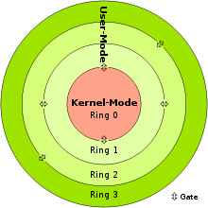
Rootkit
A rootkit is a collection of malicious software, designed to enable access to a computer or an area of its software that is not otherwise allowed and often masks its existence or the existence of other software.
The term rootkit is a compound from "root" and the word "kit".
Such software are security threats for an operating systems.
Notes:
Rootkit installation can be automated, or an attacker can install it after having obtained root or Administrator access. Obtaining this access is a result of direct attack on a system, i.e. exploiting a known vulnerability (such as privilege escalation) or a password (obtained by cracking or social engineering tactics like "phishing"). Once installed, it becomes possible to hide the intrusion as well as to maintain privileged access. Full control over a system means that existing software can be modified, including software that might otherwise be used to detect or circumvent it.
Rootkit detection is difficult because a rootkit may be able to subvert the software that is intended to find it. Detection methods include using an alternative and trusted operating system, behavioral-based methods, signature scanning, difference scanning, and memory dump analysis. Removal can be complicated or practically impossible, especially in cases where the rootkit resides in the kernel; reinstallation of the operating system may be the only available solution to the problem.^{[2]} When dealing with firmware rootkits, removal may require hardware replacement, or specialized equipment.
ootkits[edit]
A kernel-mode rootkit variant called a bootkit can infect startup code like the Master Boot Record (MBR), Volume Boot Record (VBR), or boot sector, and in this way can be used to attack full disk encryption systems.
An example of such an attack on disk encryption is the "evil maid attack", in which an attacker installs a bootkit on an unattended computer. The envisioned scenario is a maid sneaking into the hotel room where the victims left their hardware.^{[36]} The bootkit replaces the legitimate boot loader with one under their control. Typically the malware loader persists through the transition to protected mode when the kernel has loaded, and is thus able to subvert the kernel.^{[37][38][39]} For example, the "Stoned Bootkit" subverts the system by using a compromised boot loader to intercept encryption keys and passwords.^{[40][self-published source?]} More recently, the Alureon rootkit has successfully subverted the requirement for 64-bit kernel-mode driver signing in Windows 7, by modifying the master boot record.^{[41]} Although not malware in the sense of doing something the user doesn't want, certain "Vista Loader" or "Windows Loader" software work in a similar way by injecting an ACPI SLIC (System Licensed Internal Code) table in the RAM-cached version of the BIOS during boot, in order to defeat the Windows Vista and Windows 7 activation process.^{[42][43]} This vector of attack was rendered useless in the (non-server) versions of Windows 8, which use a unique, machine-specific key for each system, that can only be used by that one machine.^{[44]} Many antivirus companies provide free utilities and programs to remove bootkits.
https://en.wikipedia.org/wiki/Rootkit

Slide 43
keylogging
Keystroke logging, often referred to as keylogging or keyboard capturing, is the action of recording the keys struck on a keyboard, typically covertly, so that person using the keyboard is unaware that their actions are being monitored.
Data can then be retrieved by the person operating the logging program.

Slide 44
Denial of Service Attack
A Denial-of-Service (DoS) attack is mounted with the objective of causing a negative impact on the performance of a computer or network.
It is also known as a network saturation attack or bandwidth consumption attack.
Attackers perform DoS attacks by sending a large number of protocol packets to the network
Notes:
Hijacked computers can then be turned into zombies, spread malicious code, DDoS attack.
DDoS stands for “distributed denial of service”, and is basically the use of many computers to swamp a targeted website so that it cannot operate.

Slide 45
Intellectual Property Rights
Intellectual property rights is concerned with any act that allows access to patent, trade secrets, customer data, sales trends, and any confidential information.

Slide 46
Eavesdropping and Unauthorized Alteration
Illegal interception of telecommunications by stealing the electrical signals through EM eavesdropping
Interception of electronic funds transfer fraud
Theft of Telecommunications Services
Communications in furtherance of criminal conspiracies
Notes:
Theft of Telecommunications Services
Increasing applications for mobile computing Extension of the desktop & notebooks
Worldwide ‘app’ download was reached to 28.7 billion in 2014
• Increasing capabilities of mobile devices, High Definition Camera, massive amounts of storage
• 1.6 billion smartphones users by end 2013
The "phone phreakers" of three decades ago set a precedent for what has become a major criminal industry.
Gaining access to an organization's telephone switchboard.
Individuals or criminal organizations can obtain access to dial-in/dial-out circuits and then make their own calls or sell call time to third parties
It has been suggested that as long ago as 1990, security failures at one major telecommunications carrier cost approximately £290 million only in UK.
More recently, up to 5% of total industry turnover has been lost to fraud
Hackers in the United States illegally obtained access to Scotland Yard's telephone network and made £620,000 worth of international calls for which Scotland Yard was responsible (Tendler and Nuttall 1996).
Communications in furtherance of criminal conspiracies
Organisations in the private and public sectors rely upon information systems, so too are the activities of criminal organisations enhanced by technology
There is evidence of telecommunications equipment being used to facilitate organised drug trafficking, gambling, prostitution, money laundering, and trade in weapons.
The use of encryption technology may place criminal communications beyond the reach of law

Slide 47
Copyright and Piracy
Digital technology permits perfect reproduction and easy dissemination of print, graphics, sound, and multimedia combinations.
The temptation to reproduce copyrighted material for personal use, for sale at a lower price, or indeed, for free distribution
This has caused considerable concern to owners of copyrighted material.
Each year, it has been estimated that losses of between US$15 and US$17 billion only in USA.

Slide 48
Copyright and Piracy
The Software Publishers Association has estimated that $7.4 billion worth of software was lost to piracy in 1993 with $2 billion of that being stolen from the Internet (1994).
The cost of foreign piracy to American industry at more than $10 billion in 1996, including $1.8 billion in the film industry, $1.2 billion in music, $3.8 billion in business application software, and $690 million in book publishing. (1998)
According to the Straits Times (8/11/99) A copy of James Bond Film The World is Not Enough, was available free on the internet before its official release.
Same happened to the movie “Transformers” 2015.

Slide 49
Dissemination of offensive Material
Computer networks may also be used in furtherance of extortion.
The Sunday Times (London) reported in 1996 that over 40 financial institutions in Britain and the United States had been attacked electronically over the previous three years.
In England, financial institutions were reported to have paid significant amounts to sophisticated computer criminals who threatened to wipe out computer systems. (The Sunday Times, June 2, 1996).
Between 1993 and 1995 in which a total of 42.5 million Pounds were paid by senior executives of the organizations concerned, who were convinced of the extortionists' capacity to crash their computer systems

Slide 50
Electronic Money laundering & Tax Evasion
Electronic funds transfers have assisted in concealing and in moving the proceeds of crime.
Income may also be more easily concealed from taxation authorities.
Sales and investment frauds
The loss is so big that no exact statistics are available.
Sometime, Raise Serious questions for critical solutions?

Slide 51
Electronic vandalism, terrorism and extortion
Defense planners around the world are investing substantially in information warfare- means of disrupting the information technology infrastructure of defense systems
Attempts were made to disrupt the computer systems of the Srilankan Government by Tamil Tigers
One case, which illustrates the transnational reach of extortionists, involved a number of German hackers who compromised the system of an Internet service provider in South Florida, disabling eight of the ISPs ten servers. The offenders obtained personal information and credit card details of 10,000 subscribers

Slide 52
Few Examples of online scams
Unexpected prize scams: They inform you that you have won a prize (e/g. money, shopping vouchers, etc.) and to claim it you are asked to send money or provide personal information.
Dating scams
Jobs and investment scams: Job scams target people who are looking for a new job or who want to work from home.
Identity theft
What to Do?
Do not respond to online scams or fraud. If you receive an email or SMS which looks like a scam, the best thing to do is delete it.

Slide 53
Scenarios
A person attack website’s in order to gain access to consumer details, such as Social Security numbers, that can be used to take out credit cards or loans in another person’s name.
This type of fraud is known as identity theft
Researchers at Columbia University recently discovered a serious security flaw in certain printers, as well. Many printers automatically update their software when accepting a print job, connecting to the Internet to download the latest print drivers. Researchers believe that criminals could exploit this process by having printers download malicious files to trespass on networks the printers are connected to, or even to make the printers overheat and catch fire.
This type of fraud is known as Hardware Hijacking

Slide 54
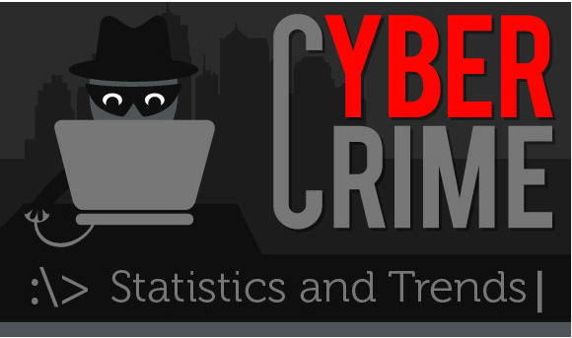

Slide 55
Cyber Crime Statistics
25% cyber crime remain unresolved
75 Million Scam Emails are sent every day claiming 20,000 victims
73% of Americans have experienced some form of cyber crime and (65% globally) do the same.
10.5% of the world’s Hackers from the UK
66% of the world’s hackers are American 7.5% are Nigerian
Brazil suffers more than any other country with 83% of the population having suffered from internet crime
The Average Internet Crime will cost the Victim $ 128

Slide 56
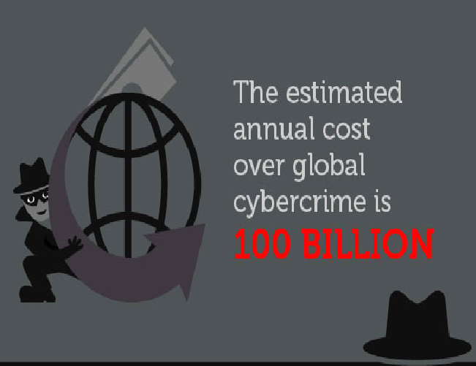

Slide 57
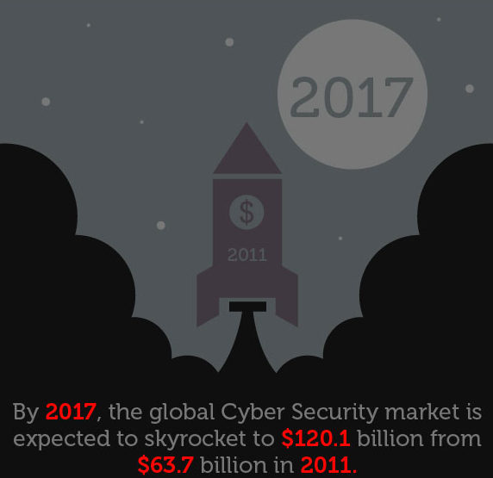

Slide 58
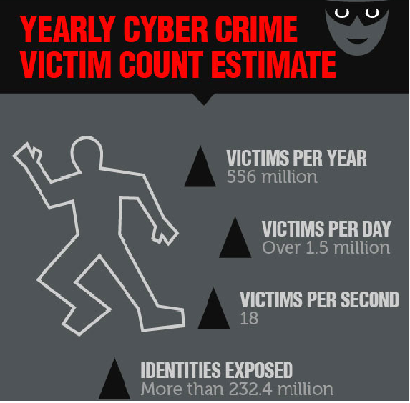

Slide 59
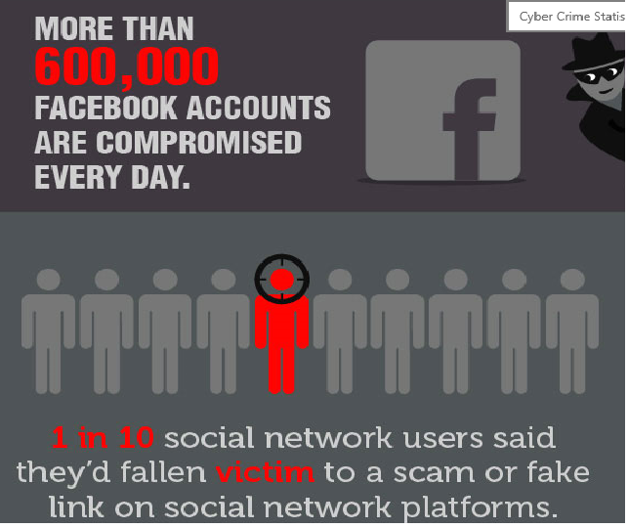

Slide 60
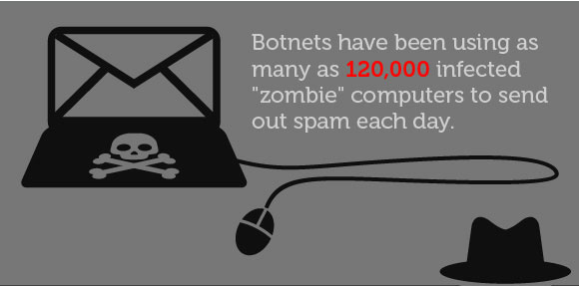
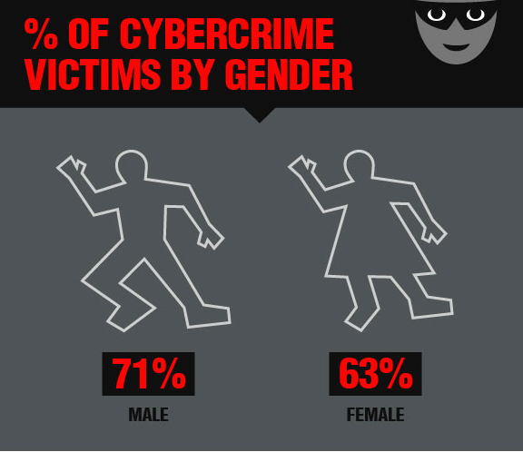

Slide 61
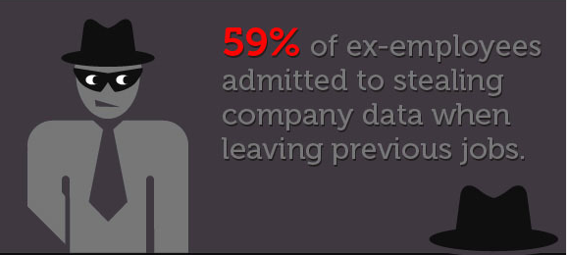
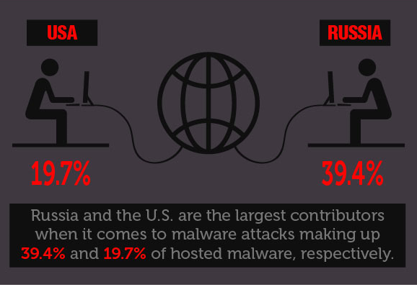

Slide 62
Common Types Of Cyber Attacks
Attack Types | %
Viruses, malware, worms, trojans | 25%
Criminal insider | 16%
Theft of data-bearing devices | 15%
SQL injection | 14%
Phishing | 11%
Web-based attacks | 9%
Social engineering | 7%
Other | 3%

Slide 63
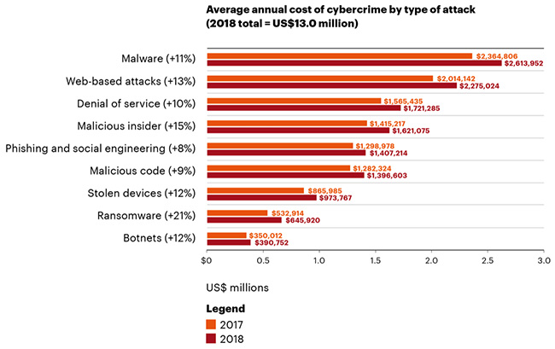
Notes:
https://www.helpnetsecurity.com/2019/03/07/cyberattack-cost-2018/

Slide 64
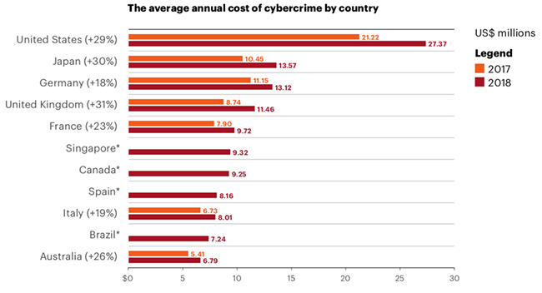
Notes:
https://www.helpnetsecurity.com/2019/03/07/cyberattack-cost-2018/

Slide 65
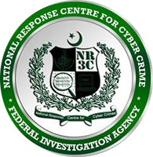

Cyber Crimes and PAKISTAN
National Response Centre for Cyber Crimes (NR3C)
http://www.fia.gov.pk/en/NR3C.php

Slide 66
National Response Centre for Cyber Crimes (NR3C)
National Response Centre for Cyber Crime (NR3C) - FIA is a law enforcement agency dedicated to fight cyber crime. Inception of this Hi-Tech crime fighting unit transpired in 2007 to identify and curb the phenomenon of technological abuse in society
National Reponse Centre for Cyber Crime (NR3C), is the latest introduction to mandate of the FIA, primarily to deal with technology based crimes in Pakistan. It is the only unit of its kind in the country and in addition to the directly received complaints also assists other law enforcement agencies in their own cases.
NR3C has expertise in Digital Forensics, Technical Investigation, Information System Security Audits, Penetration Testing and Trainings. The unit since its inception has been involved in capacity building of the officers of Police, Intelligence, Judiciary, Prosecutors and other Govt. organizations. NR3C has also conducted a large number of seminars, workshops and training/awareness programs for the academia, print/electronic media and lawyers. Cyber Scouts is the latest initiative of NR3C, in which, selected students of different private/public schools are trained to deal with computer emergencies and spreading awareness amongst their fellow students, teachers and parents.

Slide 67
NR3C Services
COMPUTER FORENSICS
MOBILE FORENSICS
VIDEO FORENSICS
NETWORK FORENSICS
TECHNICAL TRAINING

Slide 68
NR3C Achievements
A huge crackdown on illegal grey traffickers of VOIP setups in 2013 & 2014, whereby 111 successful raids were carried out, averting a loss of 2946 million Rs per month to Govt.
Estimate cost of seized equipment in these cases exceed 5,000 million Rupees
Handled complaints related to online defamation, harassment, threats and blackmailing via social networking sites such as Facebook, Twitter
NR3C has successfully registered and investigated crimes related to internet frauds & scams, such as Lottery Fraud, Job Scams, Car Fraud, Click Fraud, Internet Marketing Scams
Rendered technical facilitation of audio and video forensic analysis in cyber terrorism cases
12, 458 individuals from all walks of life have been trained by NR3C to serve the purpose of cyber crime mitigation
Notes:
ACHIEVEMENTS
A huge crackdown on illegal grey traffickers of VOIP setups in 2013 & 2014, whereby 111 successful raids were carried out, averting a loss of 2946 million Rs per month to Govt. Estimate cost of seized equipment in these cases exceed 5,000 million Rupees
Handled complaints related to online defamation, harassment, threats and blackmailing via social networking sites such as Facebook, Twitter
NR3C has successfully registered and investigated crimes related to internet frauds & scams, such as Lottery Fraud, Job Scams, Car Fraud, Click Fraud, Internet Marketing Scams
Rendered technical facilitation of audio and video forensic analysis in cyber terrorism cases
Responded to financial sectors grievances, relating to ATM skimmers, banking frauds, money exchange embezzlements, credit card frauds and e-banking frauds
AWARENESS AND TRAINING
Technical facilitation extended through digital forensic analysis, cyber tracking, digital crime investigation to local law enforcement agencies in cases such as murder, robbery, extortion and many more
Technical trainings on cyber crime, digital forensics, information security to law enforcement agencies like IB, ISI, NAB, ANF, Local Police
Conducted awareness workshops and seminars at various academic institutes and organizations
Trainings imparted on digital forensic comprehension for interpreting forensic reports, evidence extraction methods, laws application to judicial community
12, 458 individuals from all walks of life have been trained by NR3C to serve the purpose of cyber crime mitigation
RESEARCH AND DEVELOPMENTS
Developed LEAD "Live Evidence Acquisition Dongle" a forensic tool toextract live evidence
Developed a tool to help track and identify the location of e-mails originating from unknown source
Developed in-house software application for forensic request management
Developed in-house software application for complaints management andtracking
Contributed a 5 year counter cyber terrorism strategy with NACTA
Furnished a report on problems faced by law enforcement agencies to tracedown the sub-standard mobile phones with same IMEI number
Research paper published in Journal of American Science, 2010 on "DataMining Methodology in Perspective of Manufacturing Databases".

Slide 69
Cyber Crime Preventions
Information Education (Ethics+Laws)
Adminstrating Information (Trained Persons)
Use of Protection from unauthorize access (Hardware+Software)
Punishing the Criminal (Implementing Laws)

Slide 70
Cyber Crime Preventions
Antivirus And Anti spyware Software
Firewalls
Cryptography
Cyber Ethics and Laws

Slide 71
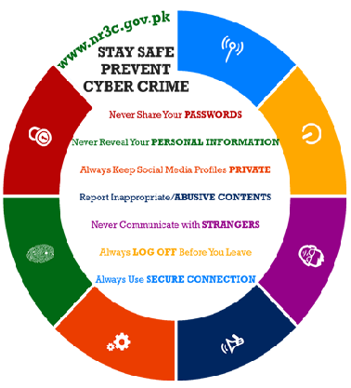
Cyber Crime Preventions by NR3C

Slide 72
Secure Digital Gadgets by NR3C
Secure your Smart Phones
Secure your Online Banking
Secure your Facebook
Secure your WI-FI
Secure your Browsing

Slide 73
Secure your Smart Phones
Always secure your smartphone with a strong password
Ensure that your device locks itself automatically
Install security software
Only download apps from approved sources
Check your apps permissions
Dont miss operating system updates
Be wary of any links you receive via email or text message
Turn off automatic Wi-Fi connection
When browsing or shopping on your phone (or computer), always look for "https" in the url instead of "http"

Slide 74
Secure your Online Banking
Never use same PIN CODE for multiple bank accounts
Never use unprotected PCs at cybercafes for internet banking
Never keep your pin code and cards together
Never leave the PC unattended when using internet banking in a publicplace
Register for Mobile SMS, Email Transaction Alerts
Never reply to emails asking for your password or pin code
Visit banks website by typing the URL in the address bar
Log off and close your browser when you are done using internet banking
When using ATM always conceal keypad before entering pin code
Before using ATM, make sure that there is no extra device installed in the surroundings

Slide 75
Secure your Facebook
Use extra security features to access account (security code, Login alert etc)
Use login notification alert
Allow specific individuals to view your contents (Videos, Photos and Friends etc.)
Control who can contact you
Block your profile from search engines

Slide 76
Secure Your WI-FI
Change Default Administrator Passwords and Usernames of the Wi-Fi Router
Use complex password and change Password after regular intervals
Position the Router or Access Point Safely
Turn off the Network / Wi-Fi routers if it is not in use

Slide 77
Secure your Browsing
What you put online will always remain there
Never trust any free online content
Dont provide personal information online to get something free
Don’t click on links inside e-mails or messages

Slide 78
Computer Crime Laws
Computer Fraud and Abuse Act:
The Computer Fraud and Abuse Act (CFAA) [18 U.S.C. Section 1030] makes it illegal for anyone to distribute computer code or place it in the stream of commerce if they intend to cause either damage or economic loss.
accessing a computer without authorization and subsequently transmitting classified government information. [Subsection 1030(a)(1)];
theft of financial information [Subsection 1030(a)(2)];
accessing a "protected computer," which the courts have recently interpreted as being any computer connected to the internet, even if the intruder obtains no data [Subsection 1030(a)(3)];
computer fraud [Subsection 1030(a)(4)];
transmitting code that causes damage to a computer system [Subsection 1030(a)(5)];
trafficking in computer passwords for the purpose of affecting interstate commerce or a government computer [Subsection 1030(a)(6)];
and computer extortion [Subsection 1030(a)(7)].

Slide 79
Computer Crime Laws
Electronic Communication Privacy Act:
The Electronic Communications Privacy Act (ECPA) [18 U.S.C. Sections 2510-2521, 2701-2710], which was signed into law in 1986, amended the Federal Wiretap Act to account for the increasing amount of communications and data transferred and stored on computer systems. The ECPA protects against the unlawful interceptions of any wire communications.

Slide 80
Further Readings
Book Chapter 11, Professional Issues in Software Engineering, M.F. Bott et al. (3rd Edition).
Cyber Crime Act2016 in Pakistan at: http://www.nr3c.gov.pk/law.html
Law Commission Consultation Paper No. 150, Legislating the criminal law: misuse of trade secrets, a consultation paper, available at www.gtnet.gov.uk/lawcomm/homepage.htm.

